Slide 1
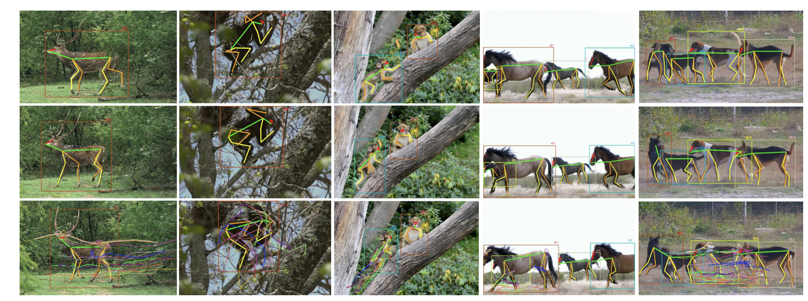
I. Keypoint Detection 1.1 Define 17 bird keypoints in skeleton.yaml (APT-36K as reference). 1.2 Use CUB-200 + AP-10K to train or fine-tune HRNet for pose detection. 1.3 Pick one normal bird image and annotate its 17 points as init pose.
II. Skeleton Motion Generation 2.1 Prepare skeleton sequences from APT-36K and augment them. 2.2 Train a Motion Diffusion Model (MDM) to learn bird skeleton dynamics. 2.3 Use init_pose and text prompt to sample a realistic motion sequence.
III. Image/Video Synthesis 3.1 Smooth skeleton motion with Savitzky–Golay filter and manual fix. 3.2 Use AnimateDiff + ControlNet to generate frames from skeletons. 3.3 Apply RIFE or FLAVR to interpolate frames for smoother playback. 3.4 Use ffmpeg to combine frames, add audio, and loop if needed.
IV. Temporal Consistency Enhancement 4.1 Use Latent Lock to keep unstable regions consistent across frames. 4.2 Apply Sliding Window Loss (β=0.1) to fine-tune Stable Diffusion. 4.3 Compare T-LPIPS and CLIP scores to select the best final video.

Slide 2
